Slide 1


Fruit Rain
Code Walkthrough
CHLOE VEDRINE | JUSTIN PORTILLO | DION DEL ROSARIO
SPRING 2023 GEORGIA GWINNETT COLLEGE

Slide 2
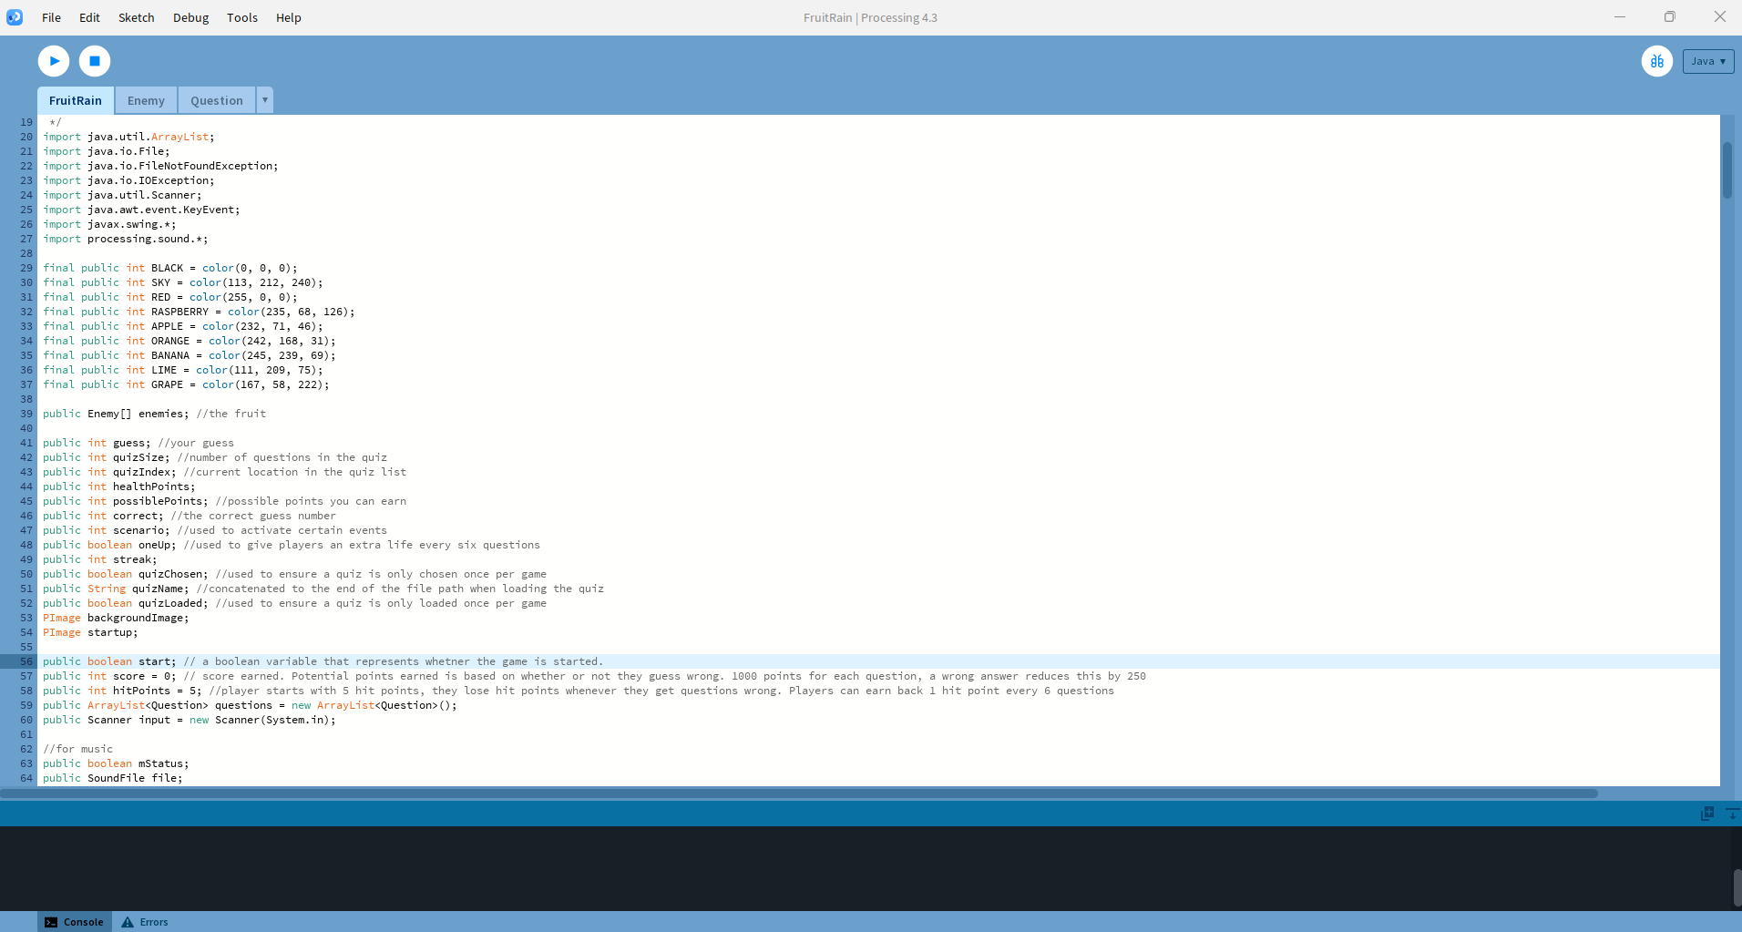
Fruit Rain Class
Everything between lines 1-81 are imported for code functionality.
FRUIT RAIN

Slide 3
Fruit Rain Class
Setup()
Purpose: Initializes the game.
This method is called once when the program starts.
Actions:
Sets up the startup screen animation.
Defines the size of the game window.
Loads images and sounds.
Initializes game variables (score, health points, enemies, etc.).
FRUIT RAIN

Slide 4
Fruit Rain Class
Draw()
Purpose: Main game loop.
Continuously updates and renders the game state.
Actions:
Displays the startup screen animation.
If the game hasn't started, displays the instructions.
If the game has started, handles quiz selection, question display, and scenario transitions (correct/incorrect answer, game over).
Updates the score and health points.
FRUIT RAIN

Slide 5
Fruit Rain Class
DisplayInst()
Purpose: Displays the game instructions on the startup screen.
Actions:
Sets text size and color.
Displays "CLICK TO START GAME" message.
FRUIT RAIN

Slide 6
Fruit Rain Class
DisplayScore()
Purpose: Displays the player's current score and streak on the screen.
Actions:
Sets text size and color.
Displays the score and streak at specified coordinates.
FRUIT RAIN

Slide 7
Fruit Rain Class
KeyPressed()
Purpose: Handles key press events.
Actions:
Starts the game when the ENTER key is pressed.
Allows the player to choose a quiz using the arrow keys.
Updates the guess based on the key pressed and checks if the guess is correct.
Updates the game state based on the correctness of the guess (updates score, health points, scenarios).
FRUIT RAIN

Slide 8
Fruit Rain Class
MouseClicked()
Purpose: Handles mouse click events.
Actions:
Starts the game when the mouse is clicked.
FRUIT RAIN

Slide 9
Fruit Rain Class
MusicSwap()
Purpose: Swaps the music tracks.
Actions:
Stops the intro music and starts the game music if the game has started.
Stops the game music and starts the intro music if the game is over.
FRUIT RAIN

Slide 10
Fruit Rain Class
LoadQuestions()
Purpose: Loads quiz questions from a file.
Actions:
Reads the quiz file specified by quizName.
Parses the questions and answers from the file.
Stores the questions in an ArrayList and returns it.
FRUIT RAIN

Slide 11
Enemy Class
Constructor
Purpose: Initializes an enemy with specified attributes.
Actions:
Calls spawnEnemy() to set initial enemy attributes based on type.
FRUIT RAIN

Slide 12
Enemy Class
GetEnemyX()
Purpose: Returns the x-coordinate of the enemy.
Actions:
Returns the enemyX value.
FRUIT RAIN

Slide 13
Enemy Class
GetEnemyY()
Purpose: Returns the y-coordinate of the enemy.
Actions:
Returns the enemyY value.
FRUIT RAIN

Slide 14
Enemy Class
GetEnemySize()
Purpose: Returns the size of the enemy.
Actions:
Returns the enemySize value.
FRUIT RAIN

Slide 15
Enemy Class
SpawnEnemy()
Purpose: Creates an enemy at a random location just outside the window.
Actions:
Sets enemy attributes (speed, size, image) based on type.
Initializes the enemy's position randomly near the top edge of the window.
FRUIT RAIN

Slide 16
Enemy Class
DrawEnemy()
Purpose: Moves the enemy to its next location and draws it.
Actions:
Calculates the next position of the enemy.
Checks if the enemy is out of sight using outOfSight().
If the enemy is out of sight, respawns it using spawnEnemy().
Updates the enemy's position and draws it.
FRUIT RAIN

Slide 17
Enemy Class
outOfSight()
Purpose: Detects if the enemy has moved out of the game window.
Actions:
Checks if the enemy has moved beyond the bottom edge of the window (since enemies only spawn from the top in this implementation).
Returns true if the enemy is out of sight, otherwise false.
FRUIT RAIN

Slide 18
Question Class
Constructor
Purpose: Initializes a question with specified attributes.
Actions:
Sets the question text, id, and type.
Initializes the answers list.
FRUIT RAIN

Slide 19
Question Class
GetText()
Purpose: Returns the question text.
Actions:
Returns the text value.
FRUIT RAIN

Slide 20
Question Class
SetAnswers(ArrayList<String> answers)
Purpose: Sets the possible answers for the question.
Actions:
Adds answers to the answers list.
FRUIT RAIN

Slide 21
Question Class
SetCorrect(int index)
Purpose: Sets the correct answer index for the question.
Actions:
Validates and sets the correct answer index.
FRUIT RAIN

Slide 22
Question Class
GetAnswers()
Purpose: Returns the list of possible answers.
Actions:
Returns the answers list.
FRUIT RAIN

Slide 23
Question Class
GetType()
Purpose: Returns the question type.
Actions:
Returns the type value.
FRUIT RAIN

Slide 24
Question Class
GetCorrect()
Purpose: Returns the correct answer index.
Actions:
Returns the correct value.
FRUIT RAIN

Slide 25
Thank you!
CHLOE VEDRINE | JUSTIN PORTILLO | DION DEL ROSARIO
SPRING 2023 GEORGIA GWINNETT COLLEGE

